Slide 1
CRIME ANALYSIS USING TABLEAU
File created on: 25/04/26 17:46:20 IST

Slide 2
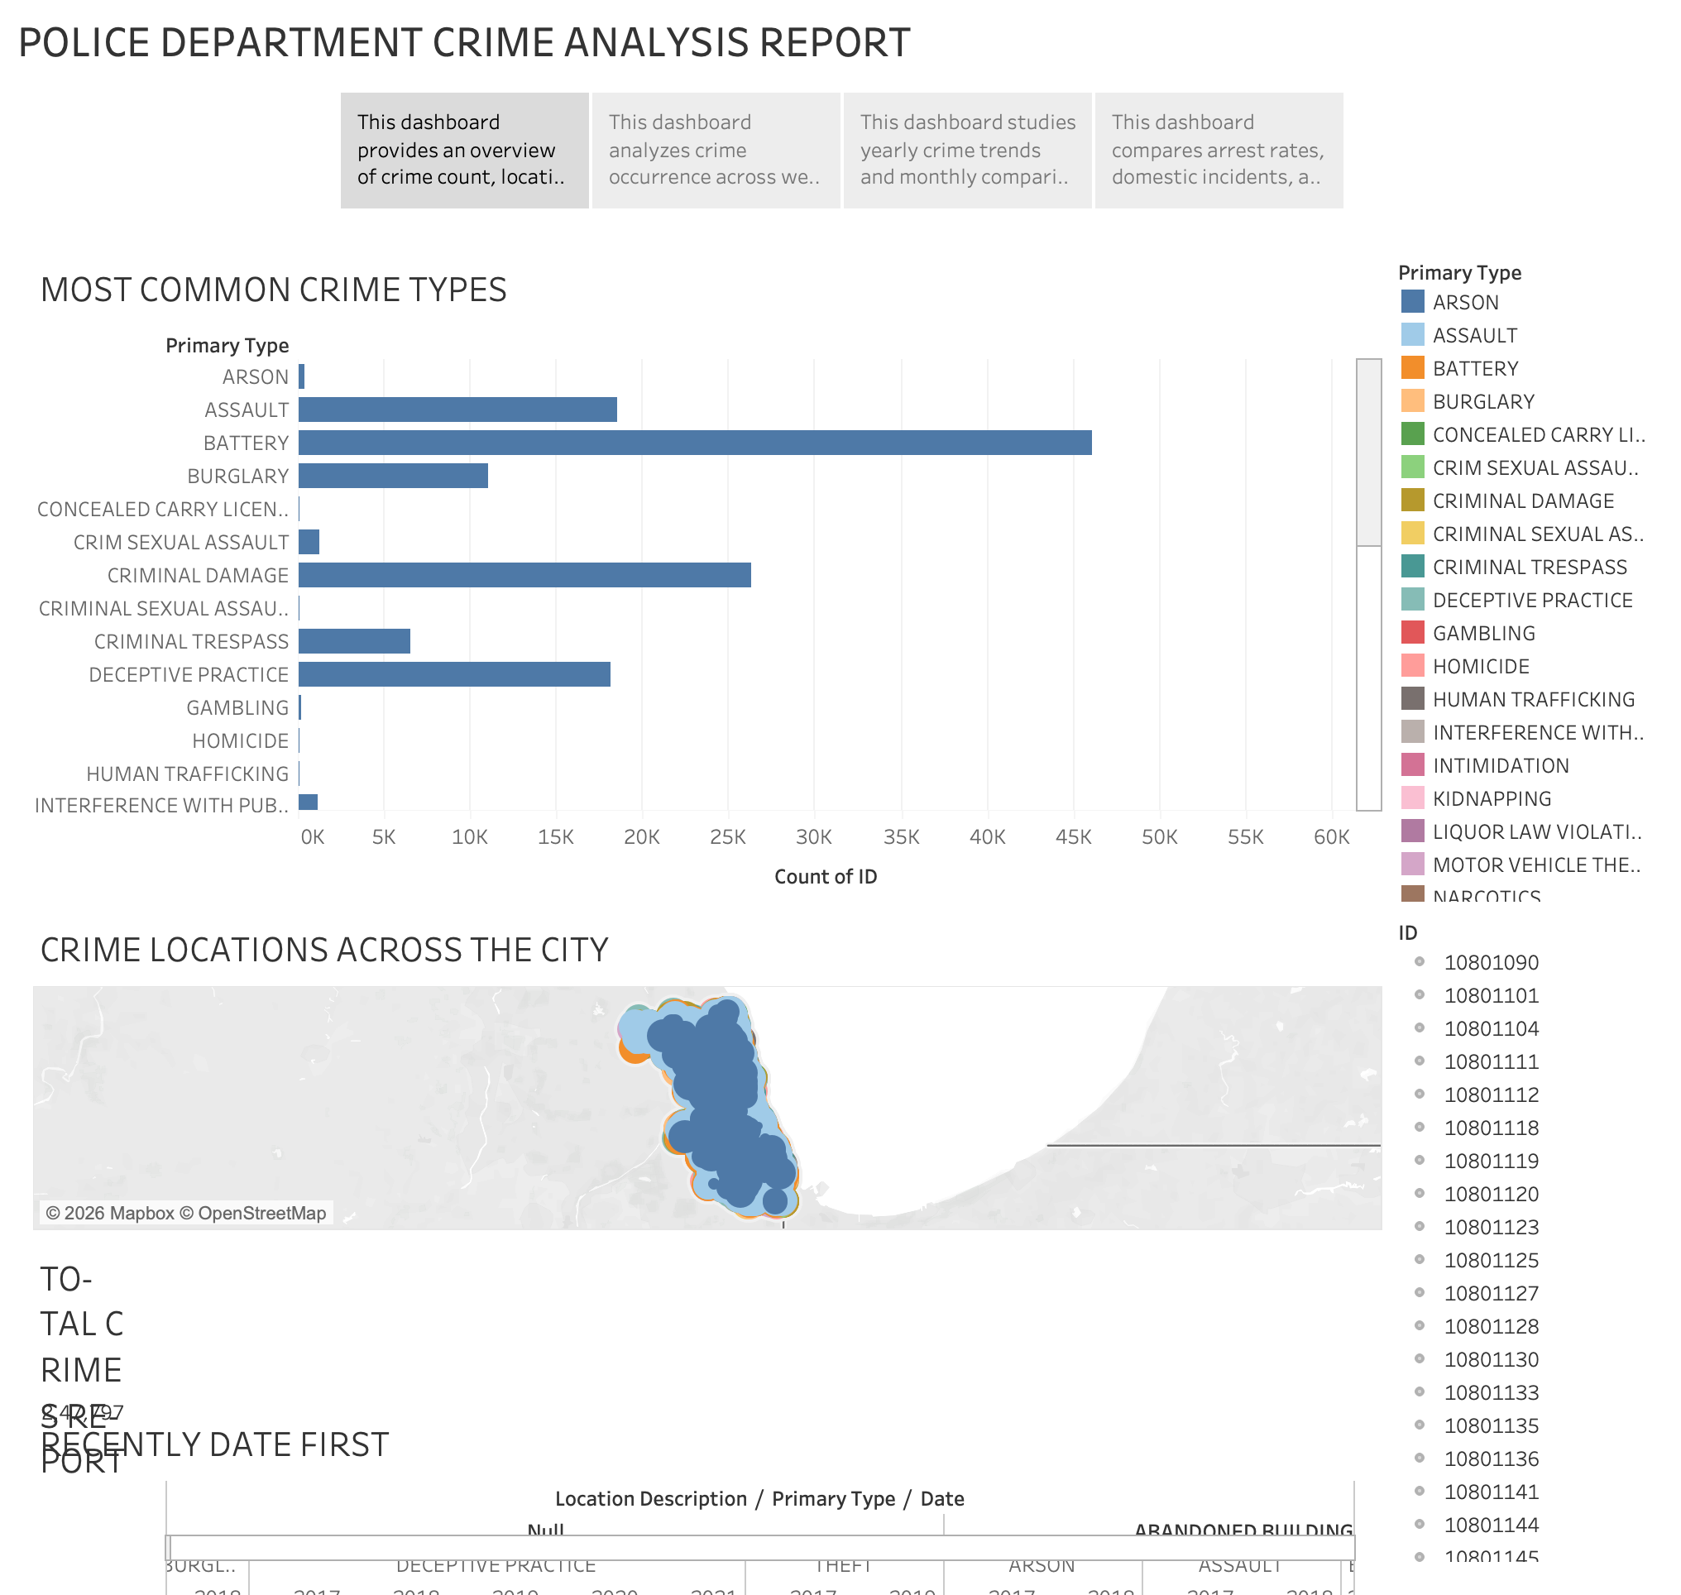

Slide 3
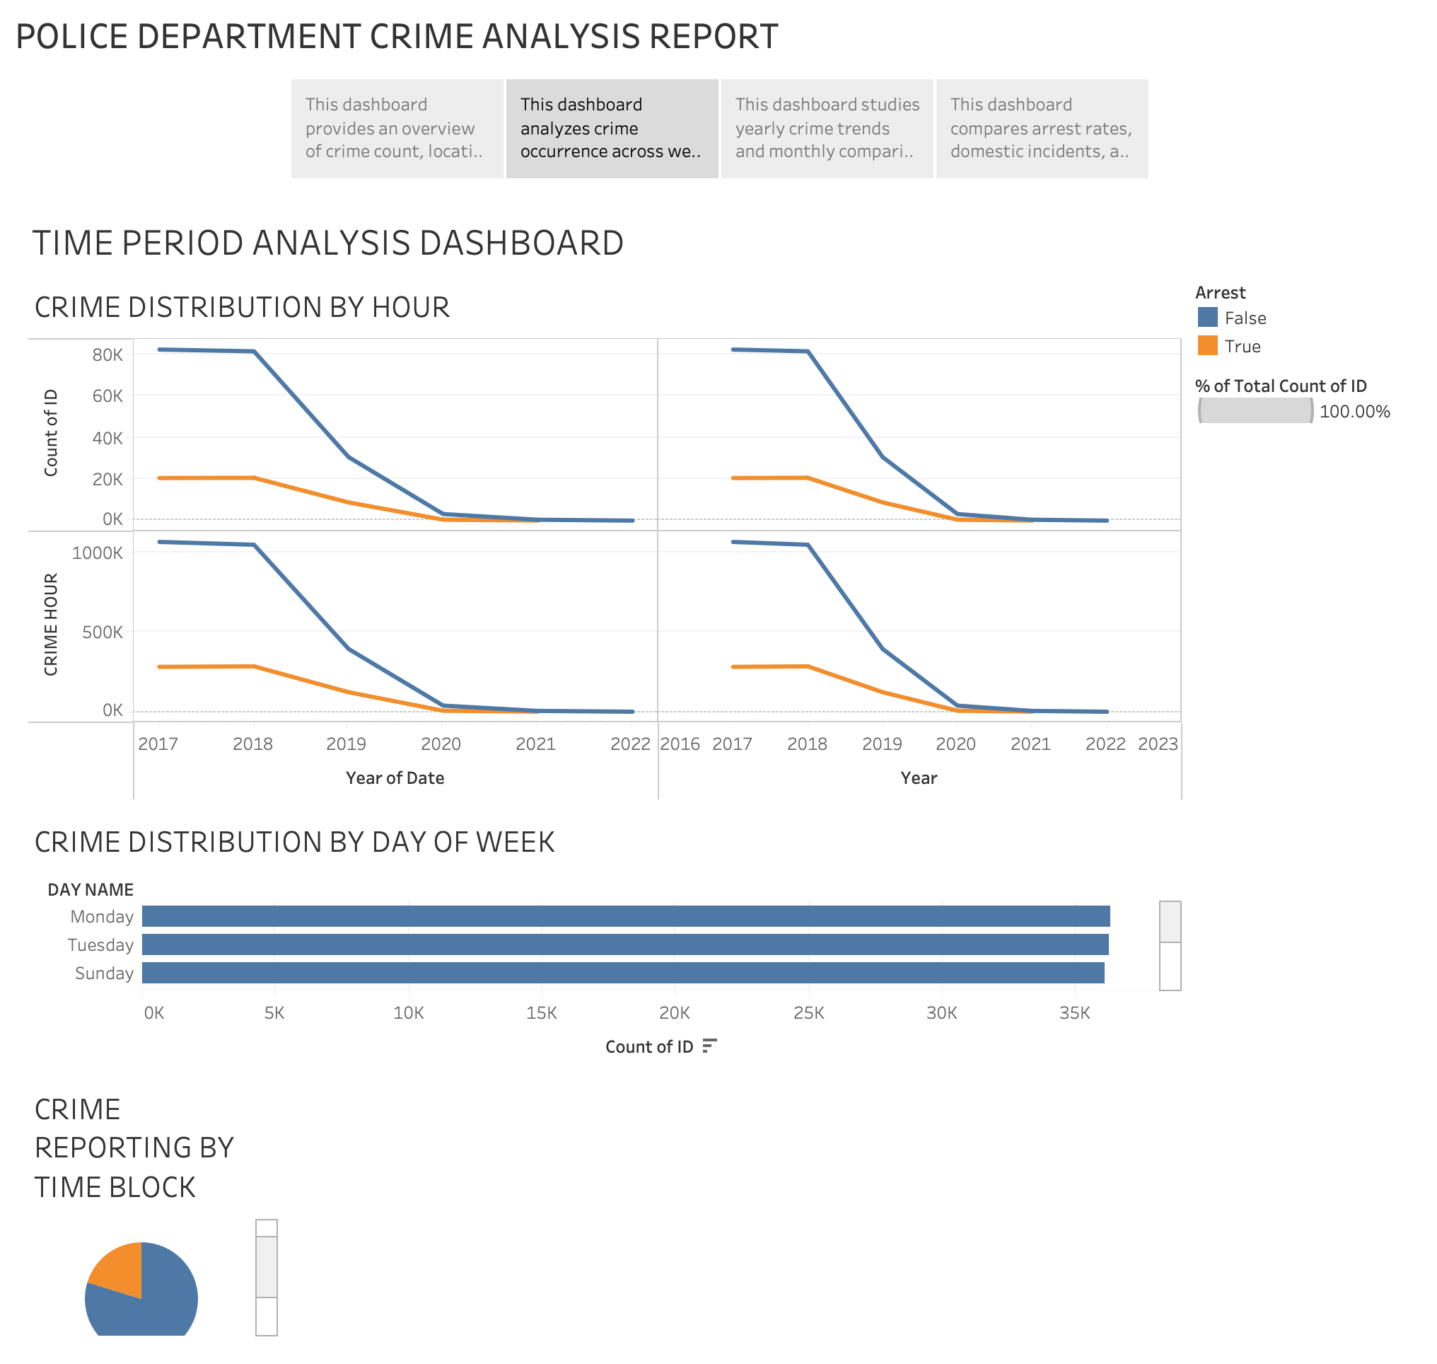

Slide 4
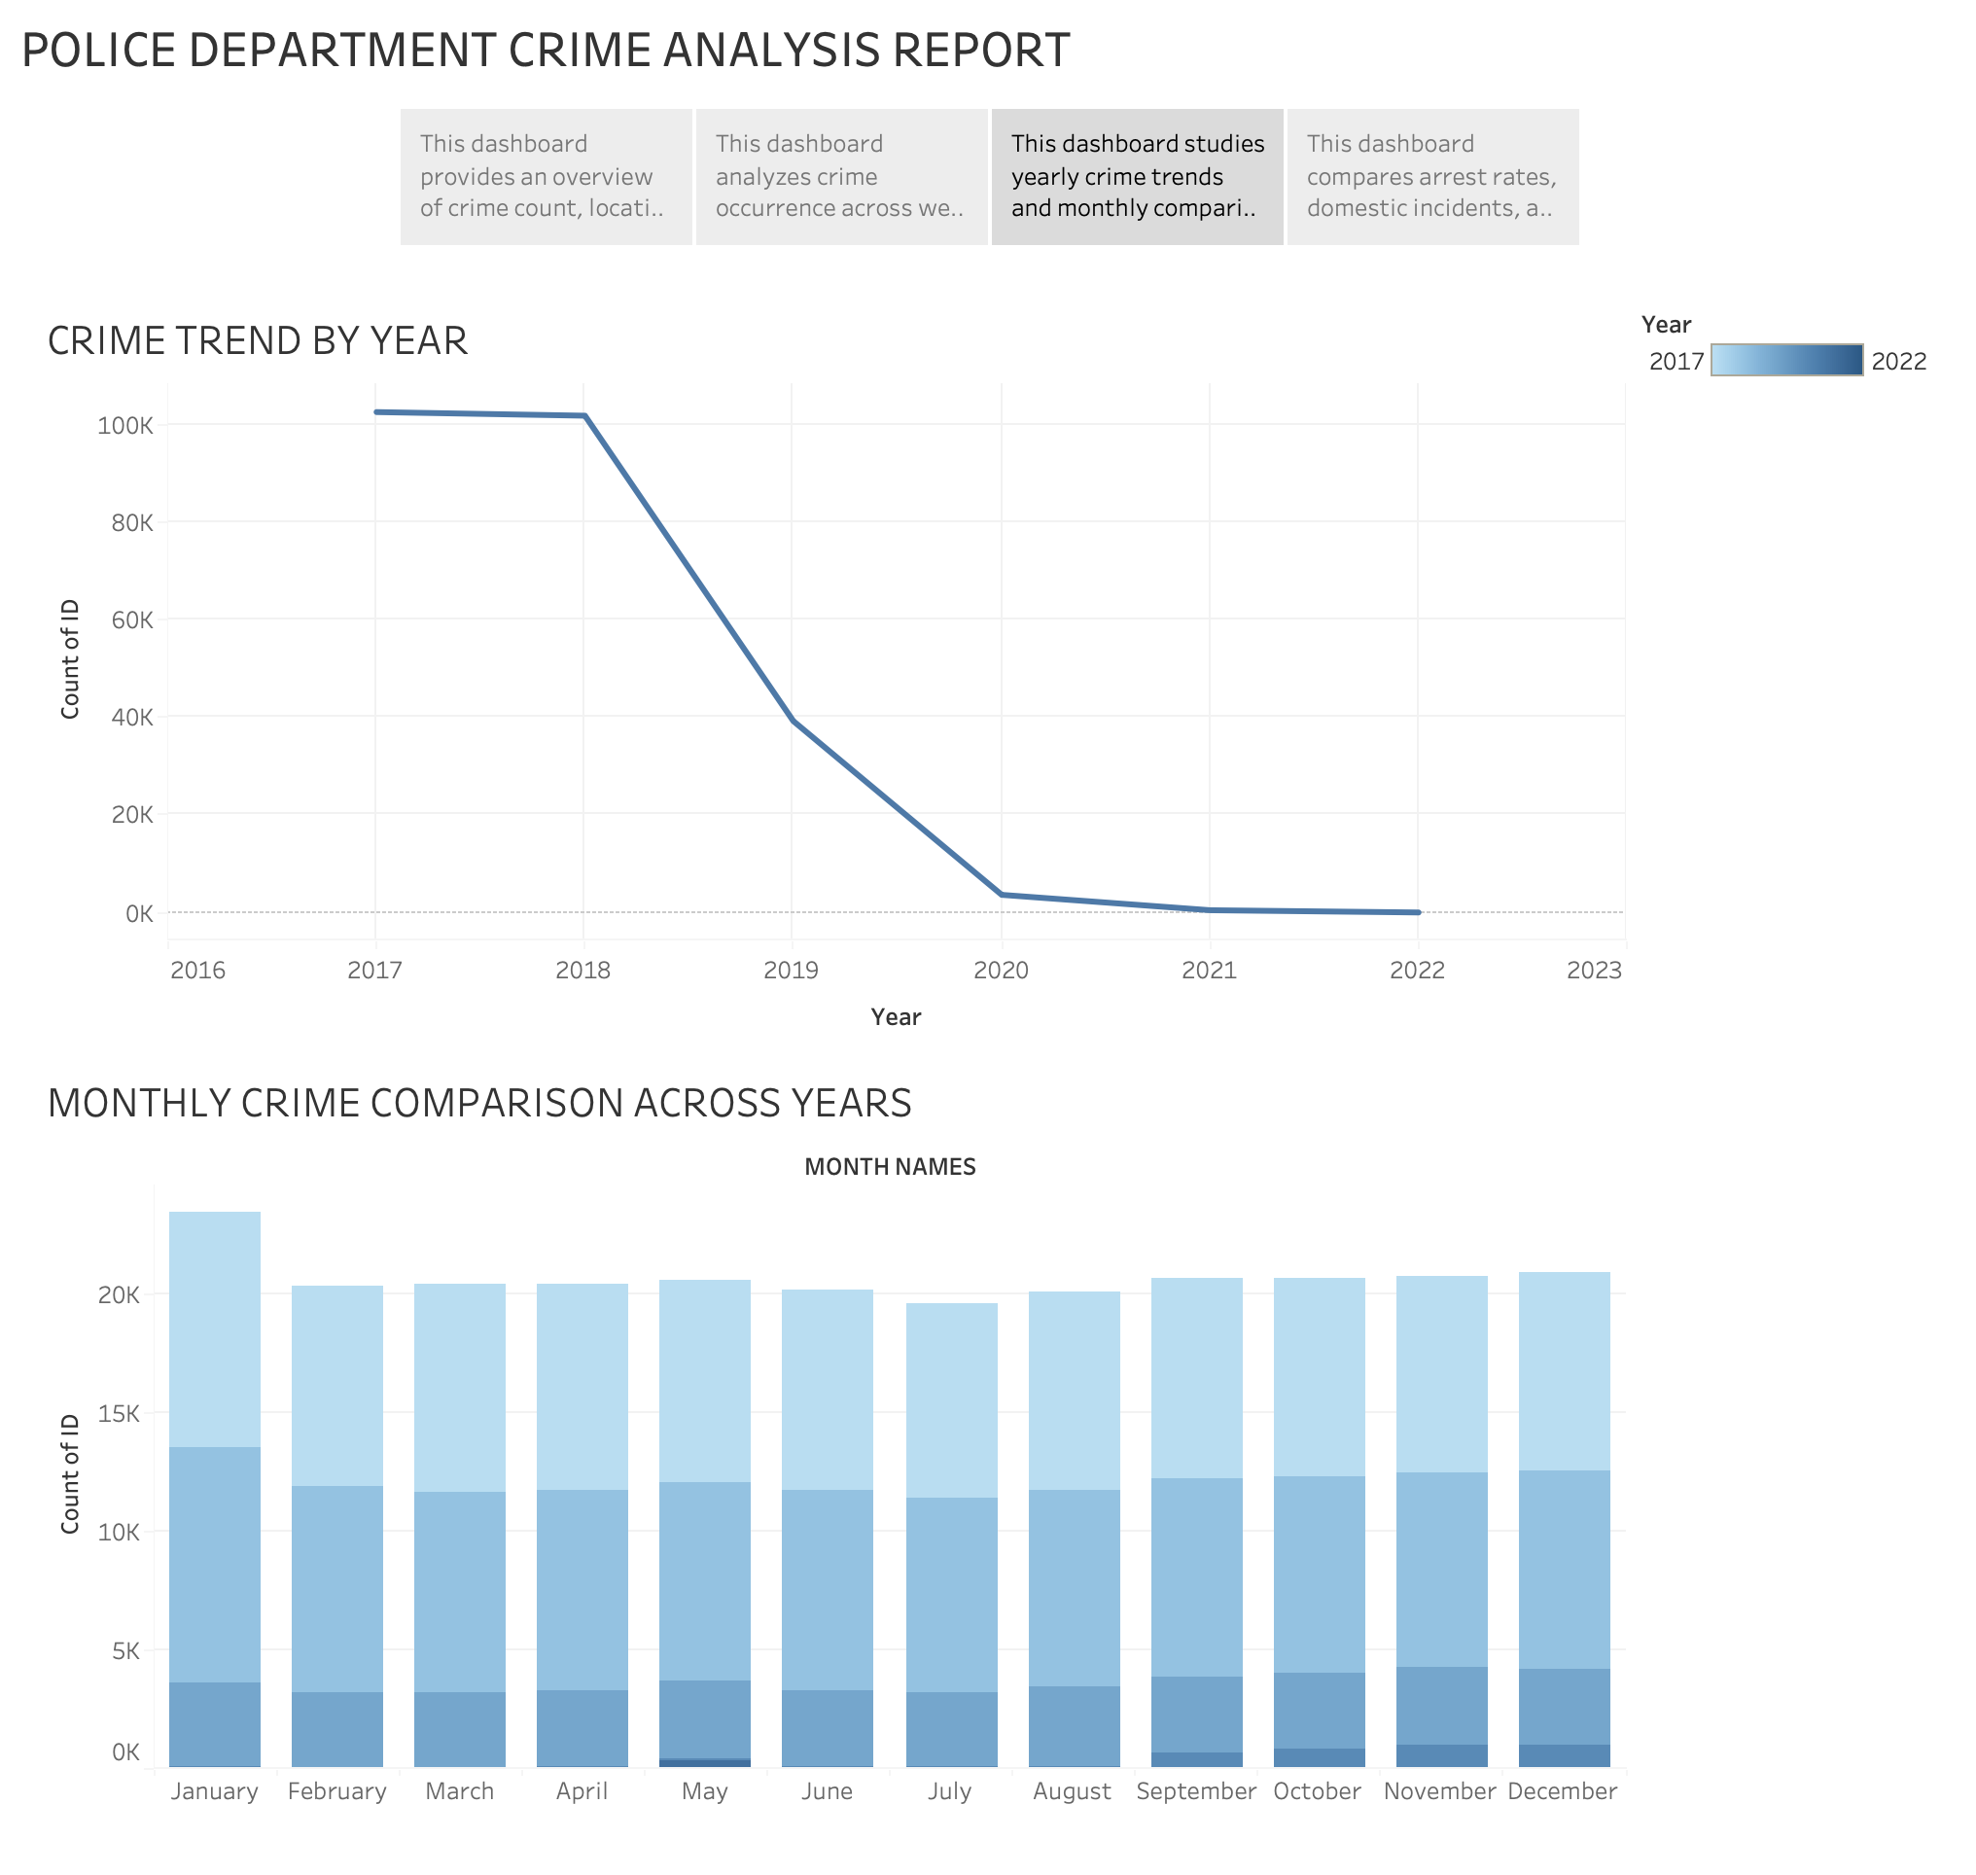

Slide 5
